Slide 1

OOM PROJECT
9 BOX PUZZLE
GROUP 1
IIB2019024 - GAJJALA DEEPAK
IIT2019203 - KRISHNA KAIPA
IIT2019214 - AKSHAT AGRAWAL
IIT2019220 - DIVYATEZ SINGH

Slide 2
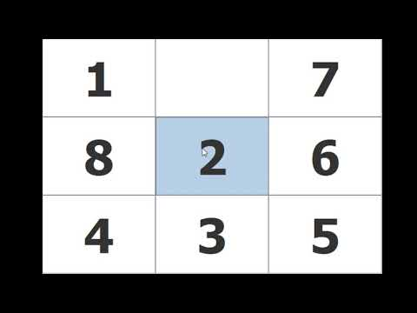
9 BOX PUZZLE 🤔🤔 never heard of it!!
No Worries..

Slide 3
What is UML diagram?
Why it is used?
It is based on diagrammatic representations of software components.
BUT there are lot of different diagrams (models) to get used to.
The reason for this is that it is possible to look at a system from many different viewpoints. A software development will have many stakeholders playing a part. For Example: Analysts,Designers,Coders,Testers,QA,The Customer, Technical Authors, etcv .All of these people are interested in different aspects of the system, and each of them require a different level of detail.
👩‍💻👩‍💻 A Coder needs -> design of the system and be able to convert the design to a low level code
🤓🤓 A Technical writer -> behavior of the system as a whole, and needs to understand how the product functions.
PURPOSE
Ready-to-use and expressive visual modeling language so they can develop and exchange meaningful models.
extensibility and specialization mechanisms to extend the core concepts.
Support higher-level development concepts

Slide 4
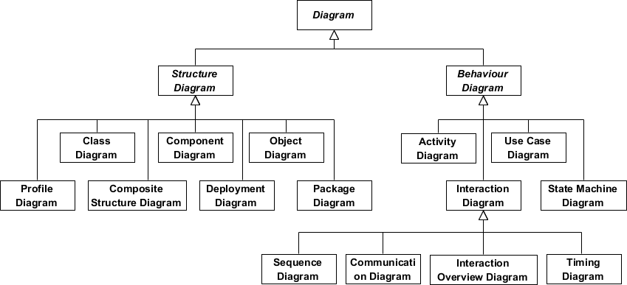
Structure diagrams show the static structure of the system and its parts on different abstraction and implementation levels and how they are related to each other.
Behavior diagrams show the dynamic behavior of the objects in a system, which can be described as a series of changes to the system over time.

Slide 5
What was asked??
Abstract of the project :
We had to create a 9-box puzzle game Software .
A nine box puzzle game consists of nine boxes that are labeled form one to eight. Player needs to arrange the labeled boxes serially.
The game counts the number of attempts by the player to win the game.
The puzzle game also accepts the name of the player and keeps track of the Players performance.

Slide 6
Our Approach to PROJECT :
Home Screen will redirect the Player to desired -> MainView extends JPanel.
Game board will have 8 buttons -> Box extends JButton.
Box will be clicked , so to listening that event -> EventHandler extends action Listener (with Sound / Other Animation ).
We needed a panel to hold boxes and display swaps -> PlayArea extends JPanel.
We needed a Brain for the Game, that will keep track of algorithm , it will initialise , it will validate moves(right or not) -> GameCPU
We also had to track Player name and score, we stored it in an Arraylist -> ScoreBoard extends JPanel
But each player data is unique -> PlayerData
What if someone does not know how to play game -> Rules extends JPanel

Slide 7
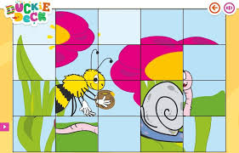
What if we want to extend this game to Picture puzzle :
Importance of :
GameCPU -> Algorithm
Box -> To accept picture
PlayerData -> Database

Slide 8
CLASS DIAGRAM
The class diagram is a central modeling technique that runs through nearly all object-oriented methods. This diagram describes the types of objects in the system and various kinds of static relationships which exist between them.
There are three principal kinds of relationships which are important:
Relationships
Aggregation
Association
Inheritance

Slide 9
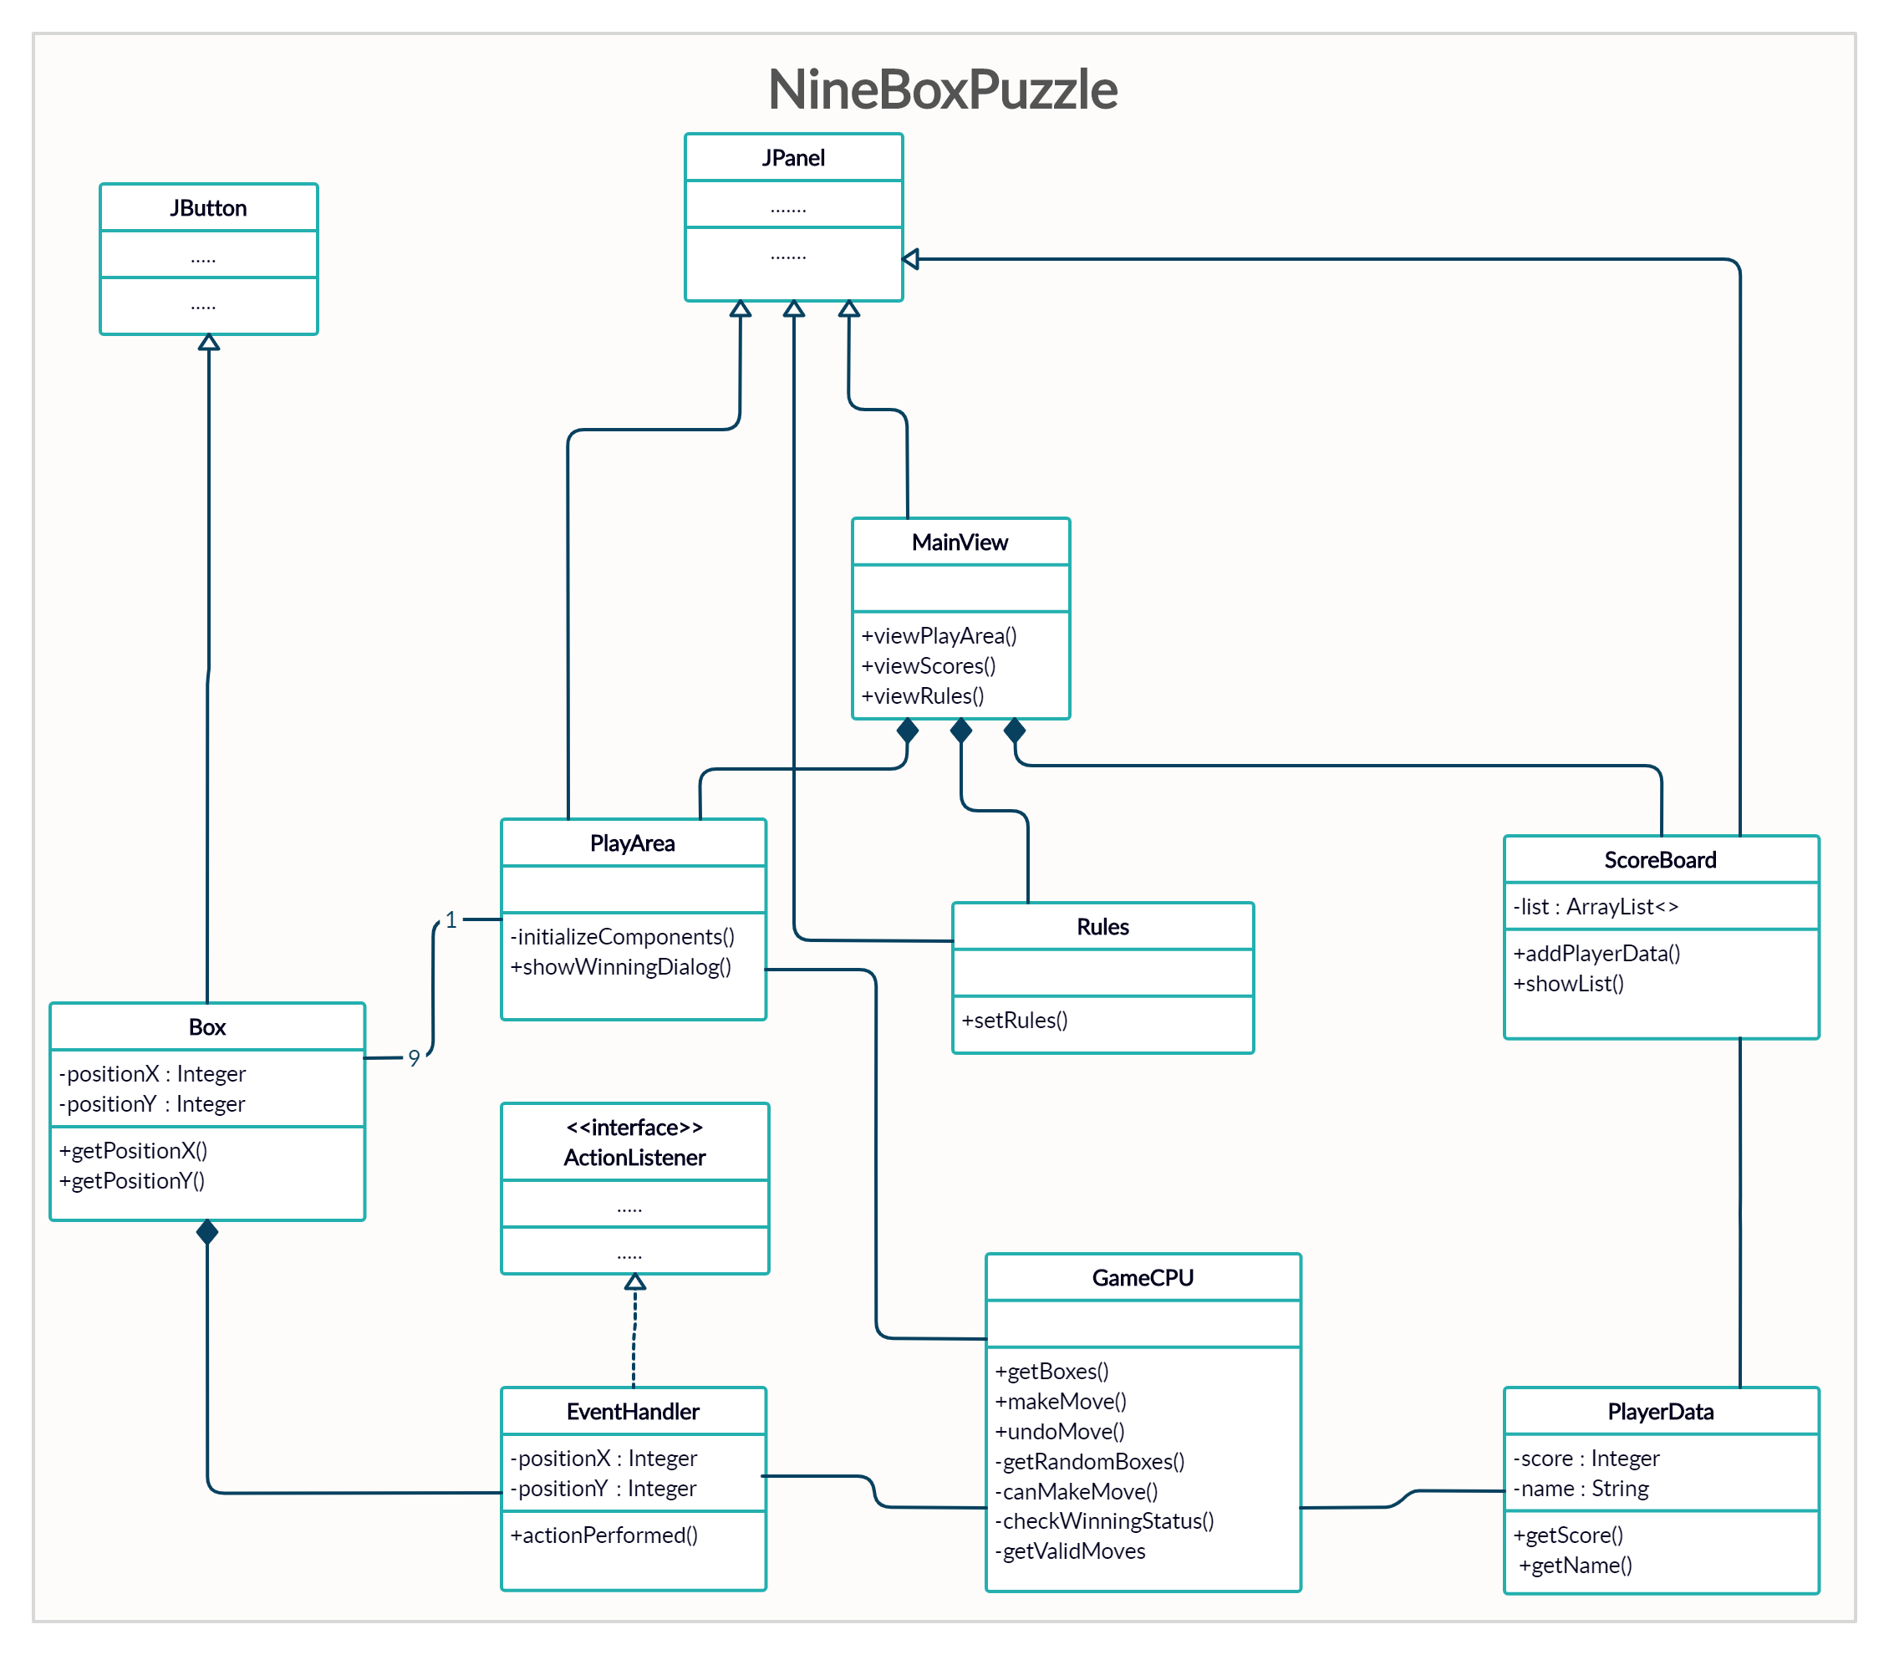

Slide 10
USE CASE DIAGRAM
Use case diagrams model how users, displayed as stick figures called “actors,” interact with the system. This type of UML diagram is a high-level overview of the relationships between actors and systems, so it can be a great tool for explaining system to a non-technical audience.
Characteristics
Organizes functional requirements
Describes one main flow of events (main scenarios) and possibly other exceptional flows (alternatives)
Models the goals of system / actor (user) interactions

Slide 11
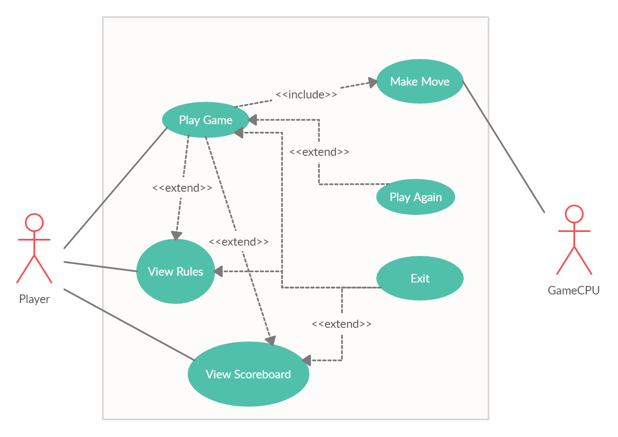
Secondary Actor
Primary Actor

Slide 12
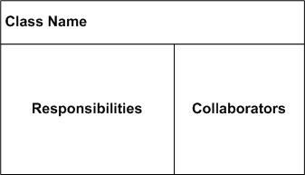
Class Responsibility Collaborator CRC DIAGRAM
A Class Responsibility Collaborator (CRC) model is a collection of standard index cards that have been divided into three sections, A class represents a collection of similar objects, a responsibility is something that a class knows or does, and a collaborator is another class that a class interacts with to fulfill its responsibilities.
Class Name

Slide 13
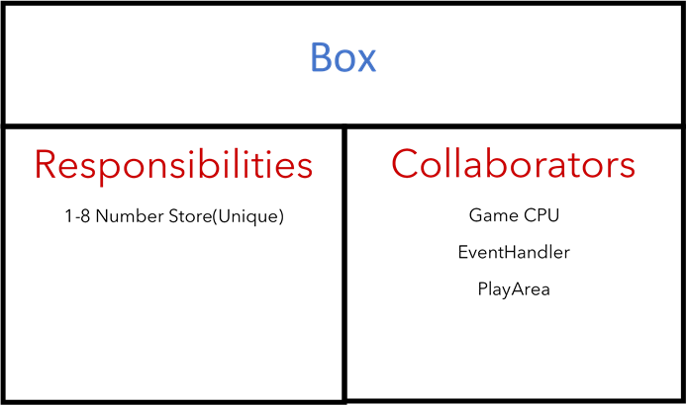
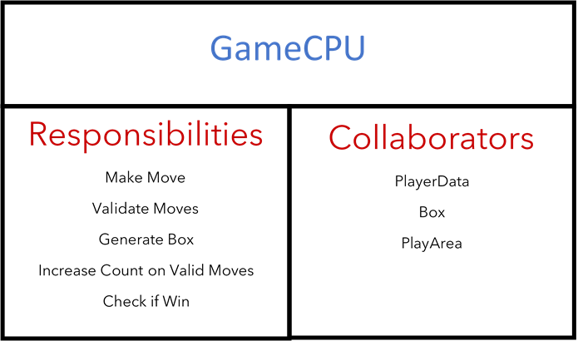
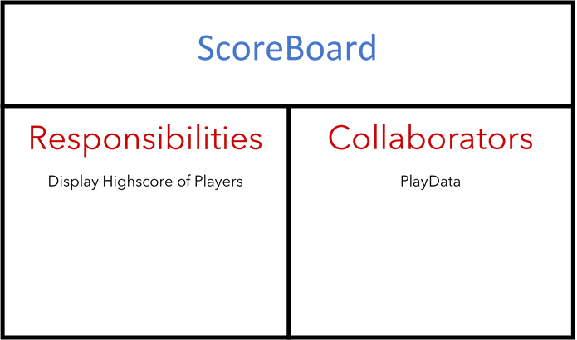

Slide 14
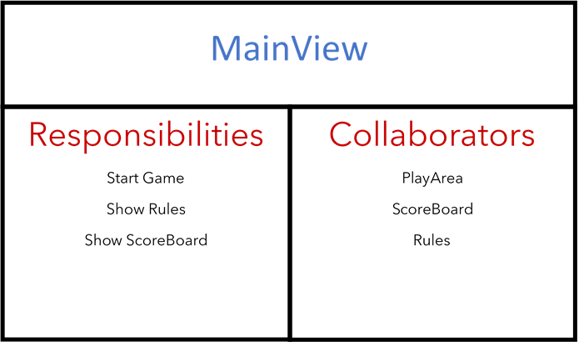
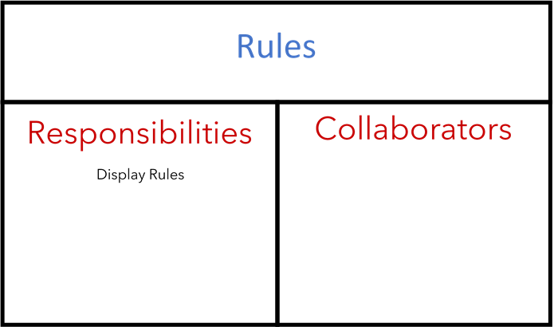
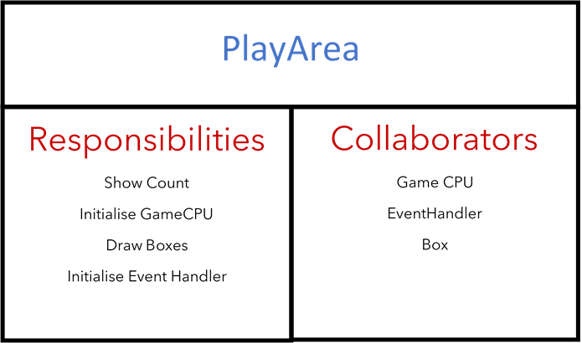
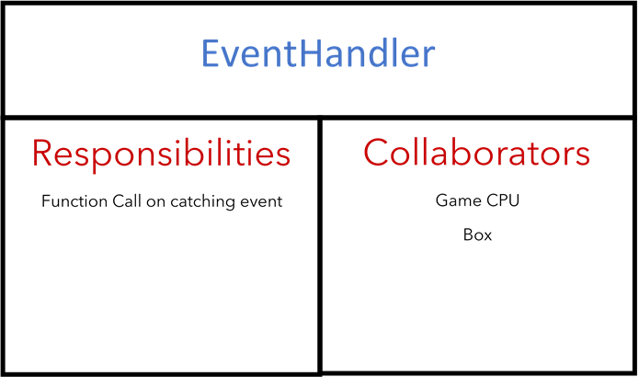

Slide 15
Thanks..

